Slide 1
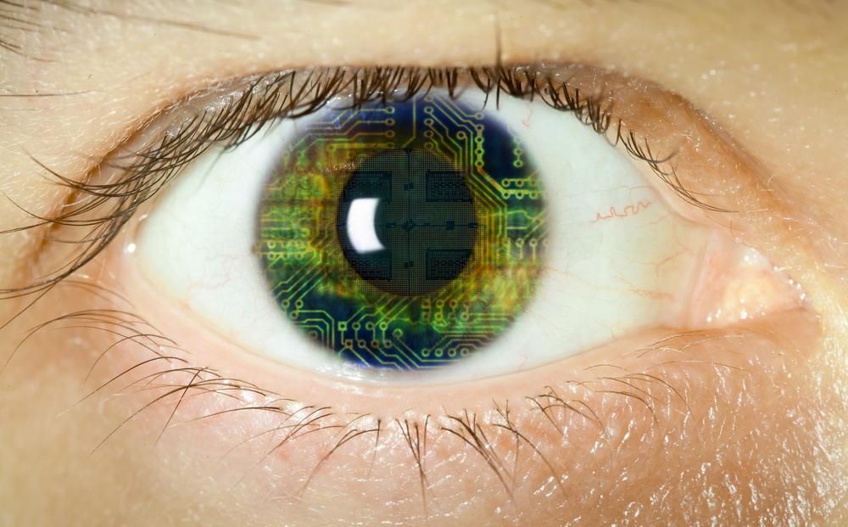
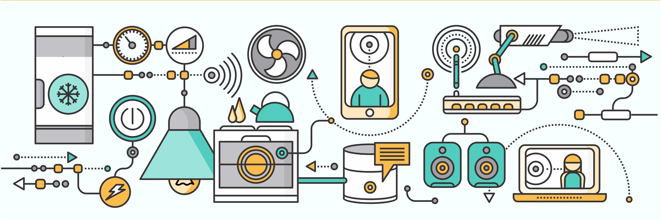
Internet of Things (IoT) :
From the Lens of QE&A

Slide 2
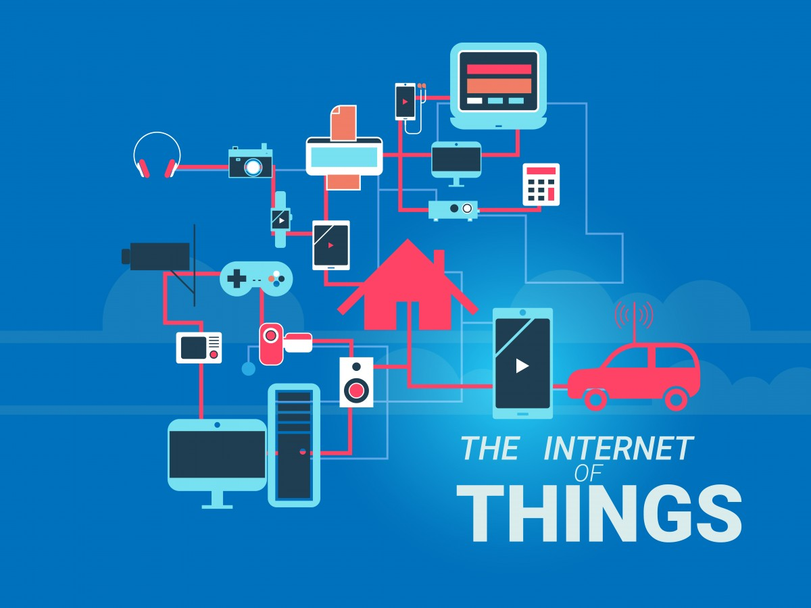
Agenda
Technical Introduction : Internet of Things (IoT)
IoT Ecosystem
IoT Categorization
IoT in Financial Services
IoT Testing Types and Strategy
IoT Communication and Transportation Protocols
IoT Testing Challenges and needs
IoT QA @ Cognizant
Cognizant IoT QA Solutions
Internet of Things – Industry perspective
Q&A

Slide 3
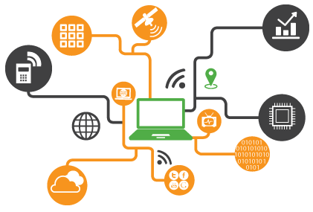
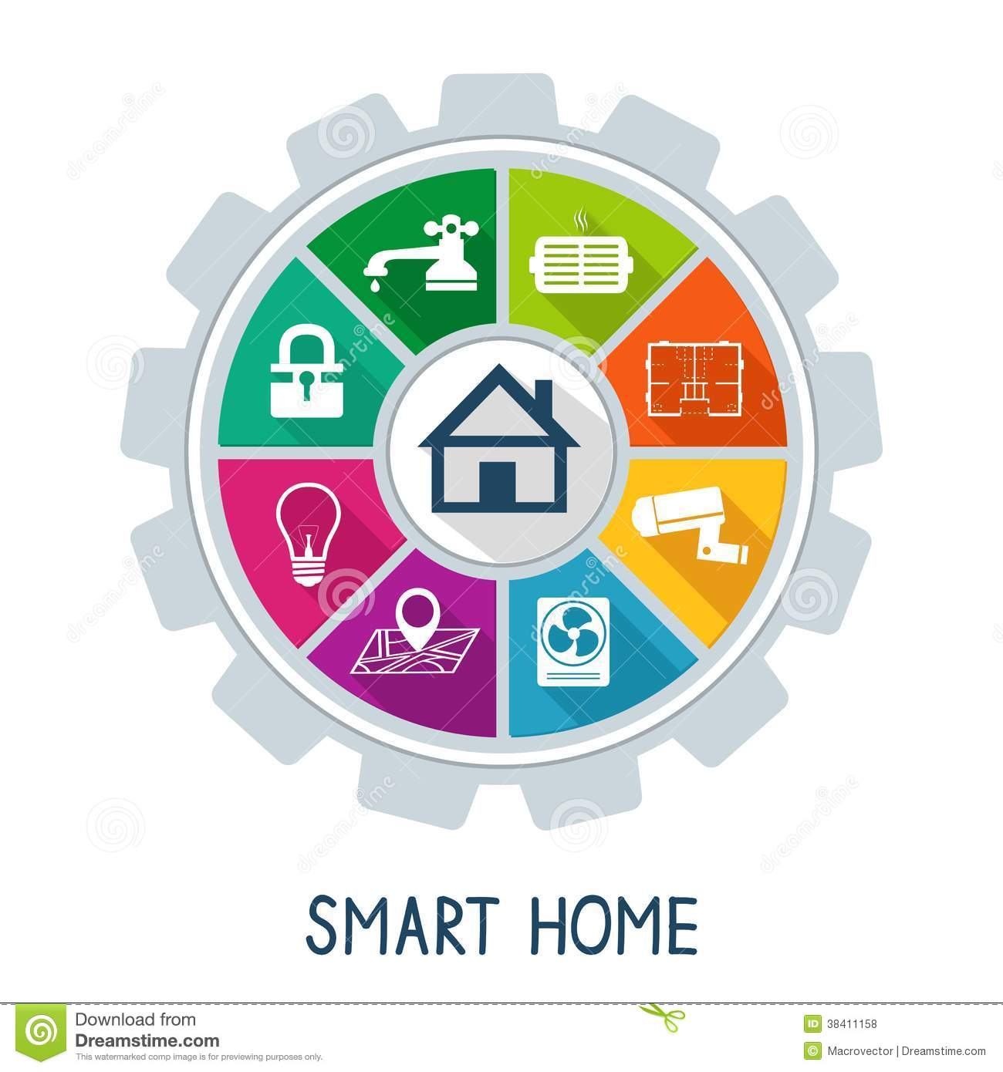
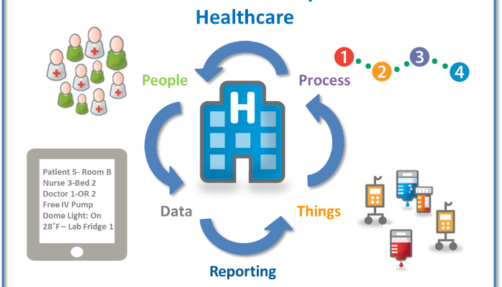

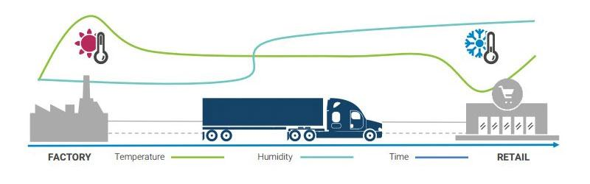
Technical Introduction :Internet of Things (IoT)
The Idea that all devices surround us will be connected and communicated together.
Each thing is a node in the network, capable to communicate with other things in the network.
Devices collect useful data with the help of various existing technologies and autonomously flow the data between other devices.
Fields of application :

Slide 4

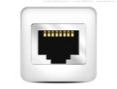




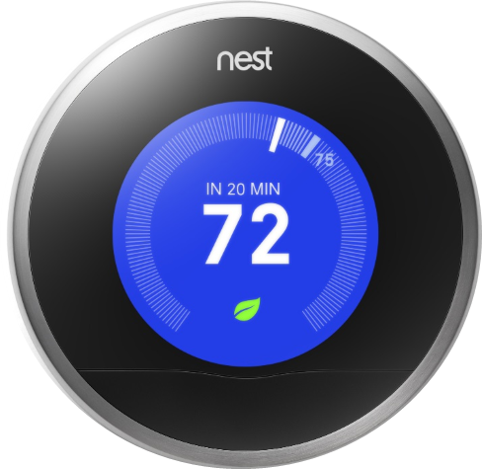

















The IoT Eco-System

Slide 5
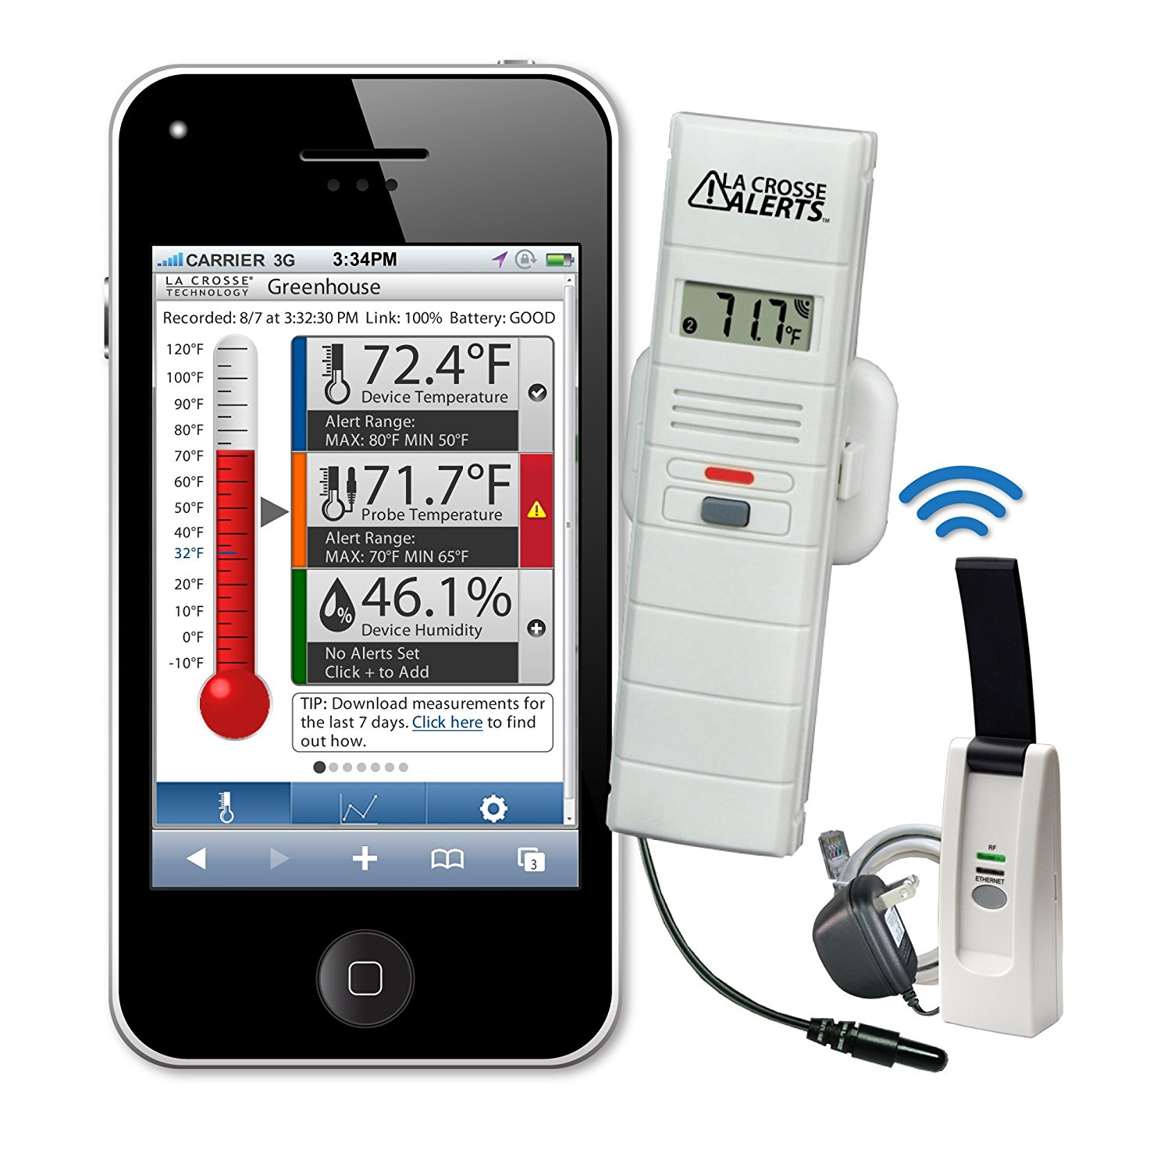
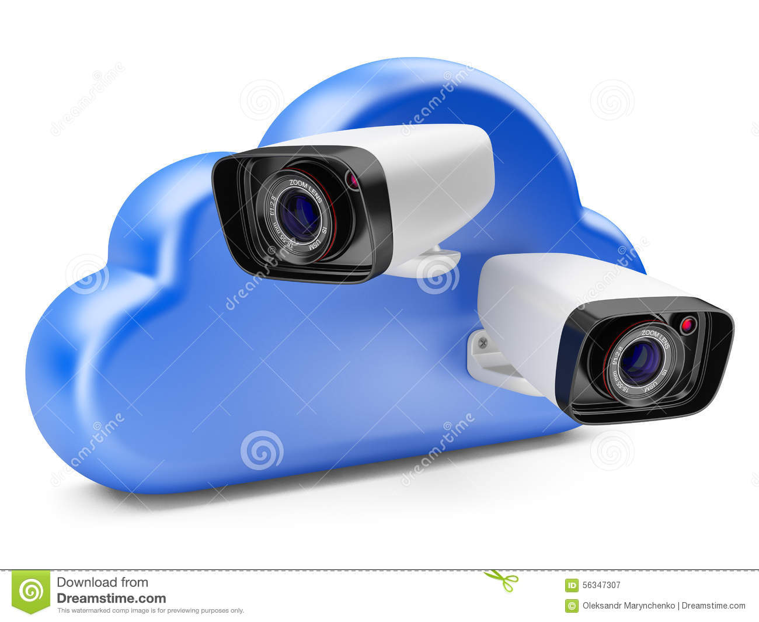
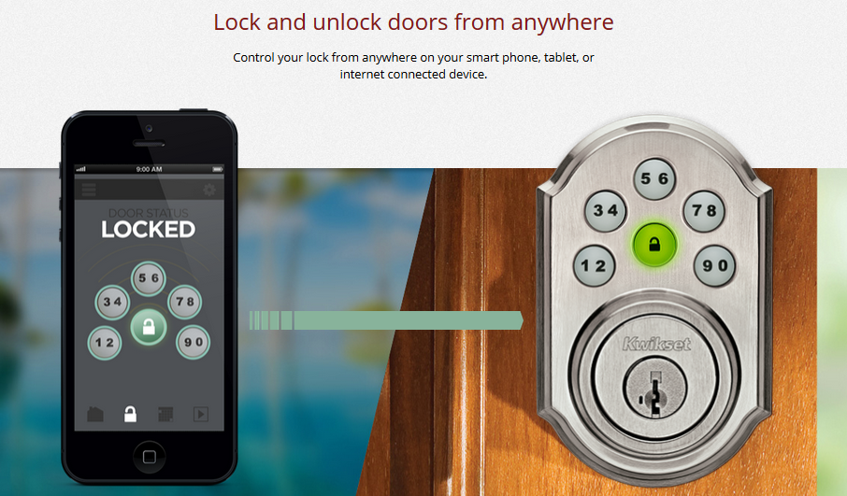
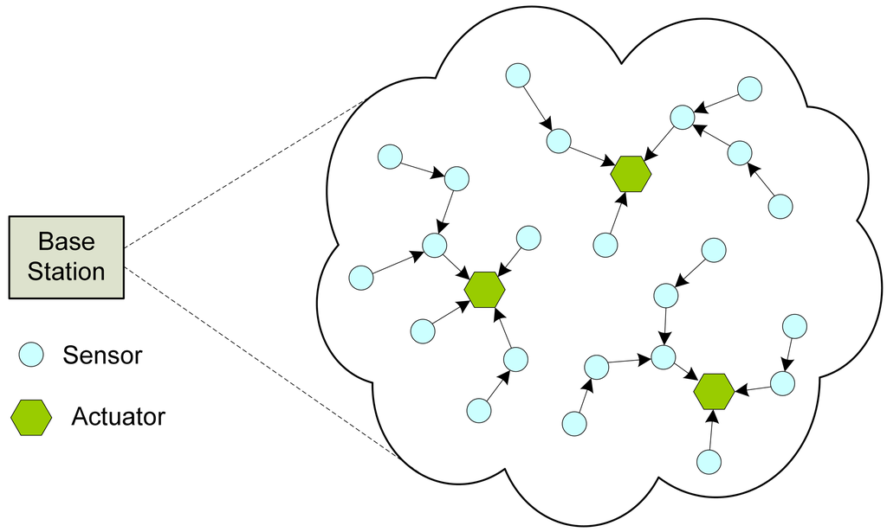
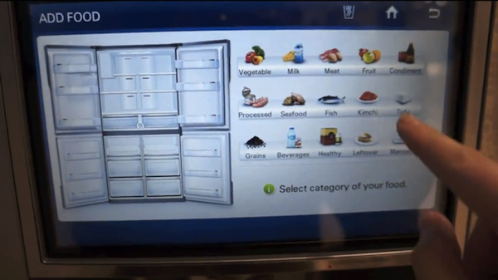
Internet of Things : Categorization
Consumer IoT
Industrial IoT
Machine to Human interaction
Human to Machine interaction
Machine to Machine interaction
In the ecosystem , an entity uses a remote (e g., Smartphone or tablet) to send a command ,or request for information ,over a network to a device
The device then performs the command and send back information over the network to be analysed and displayed on the remote
Data generated by the IoT device can be analysed and stored ,including the cloud, the local database or on the IoT device itself

Slide 6
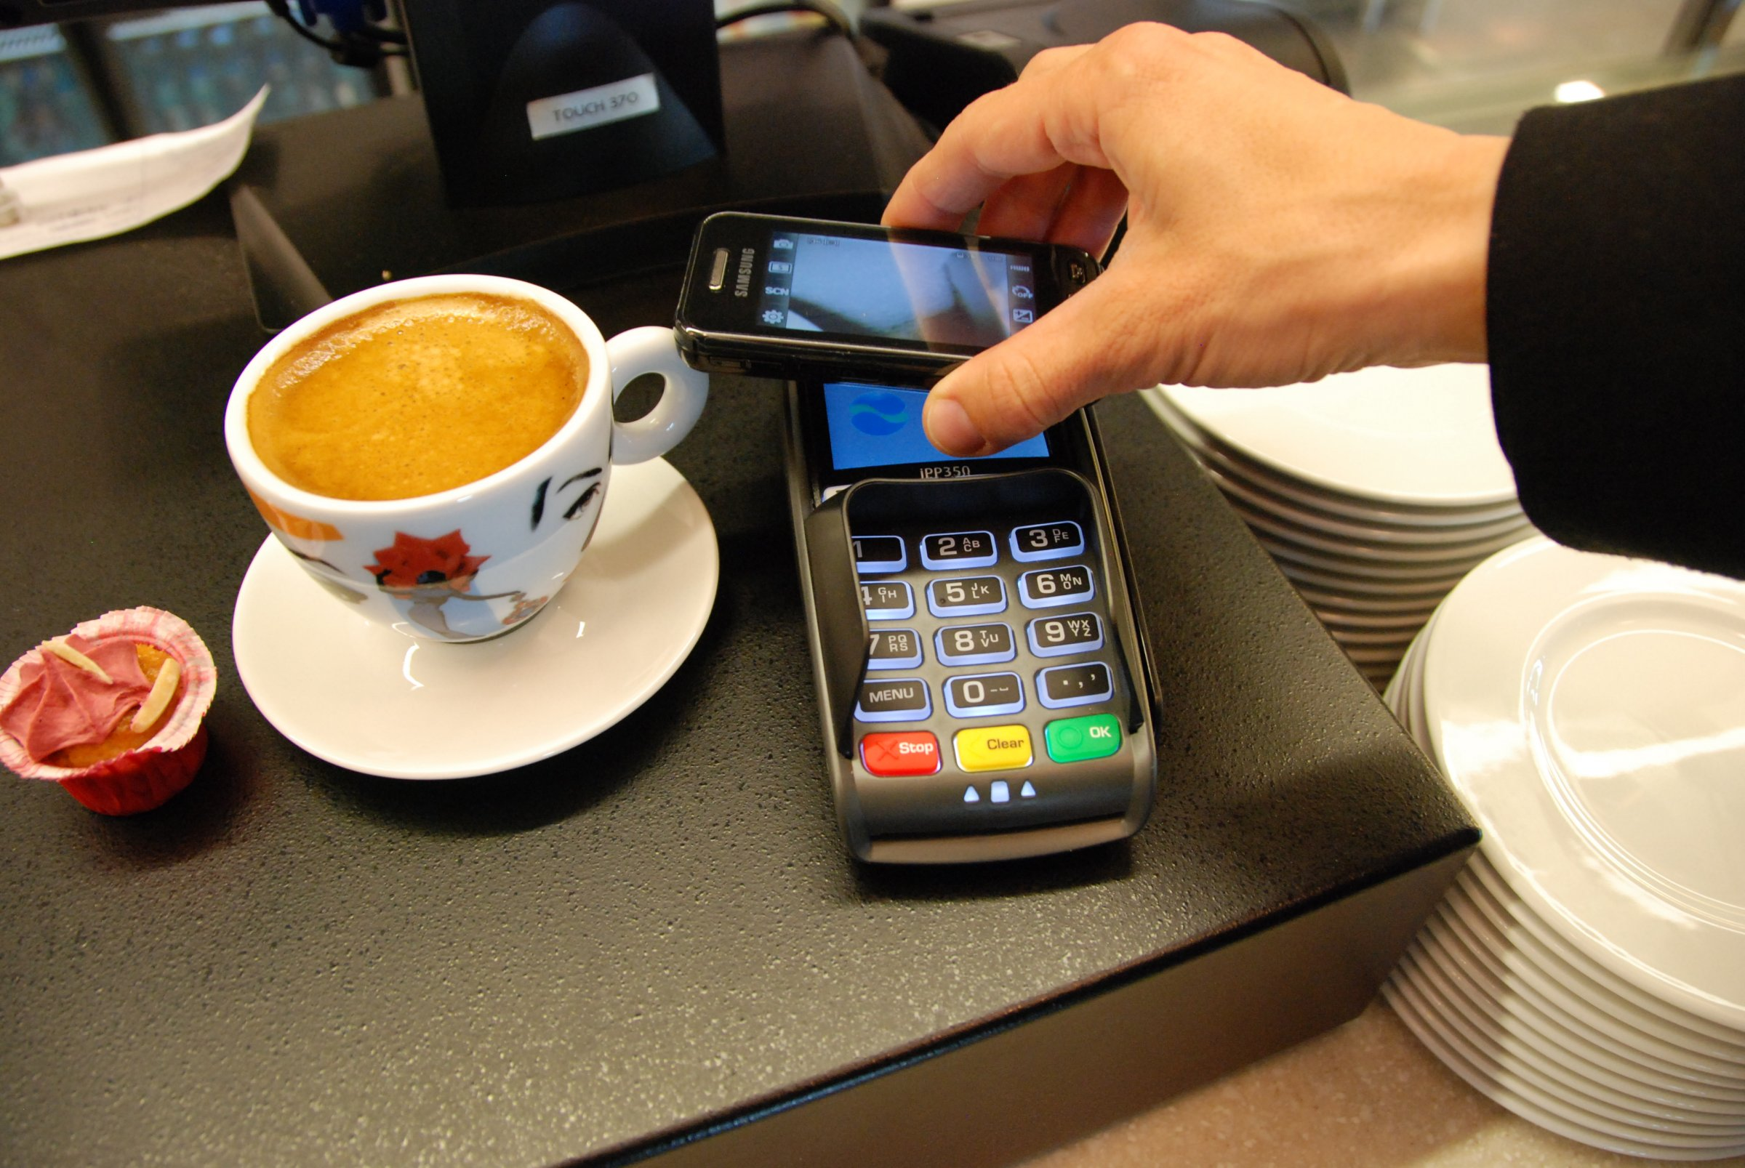
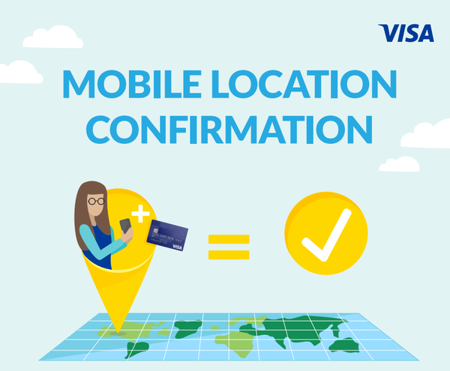
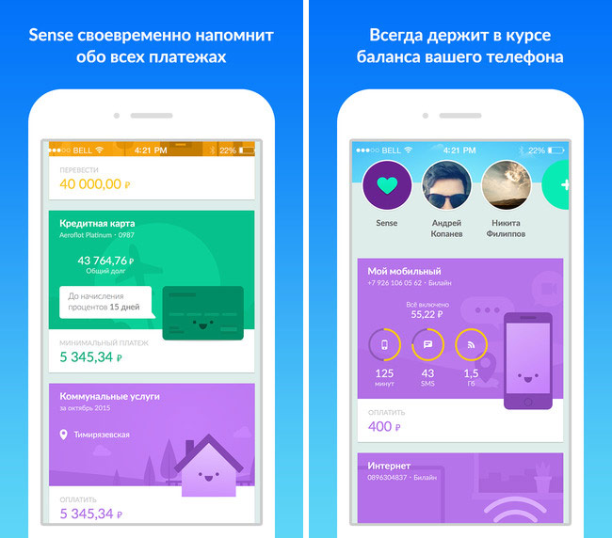
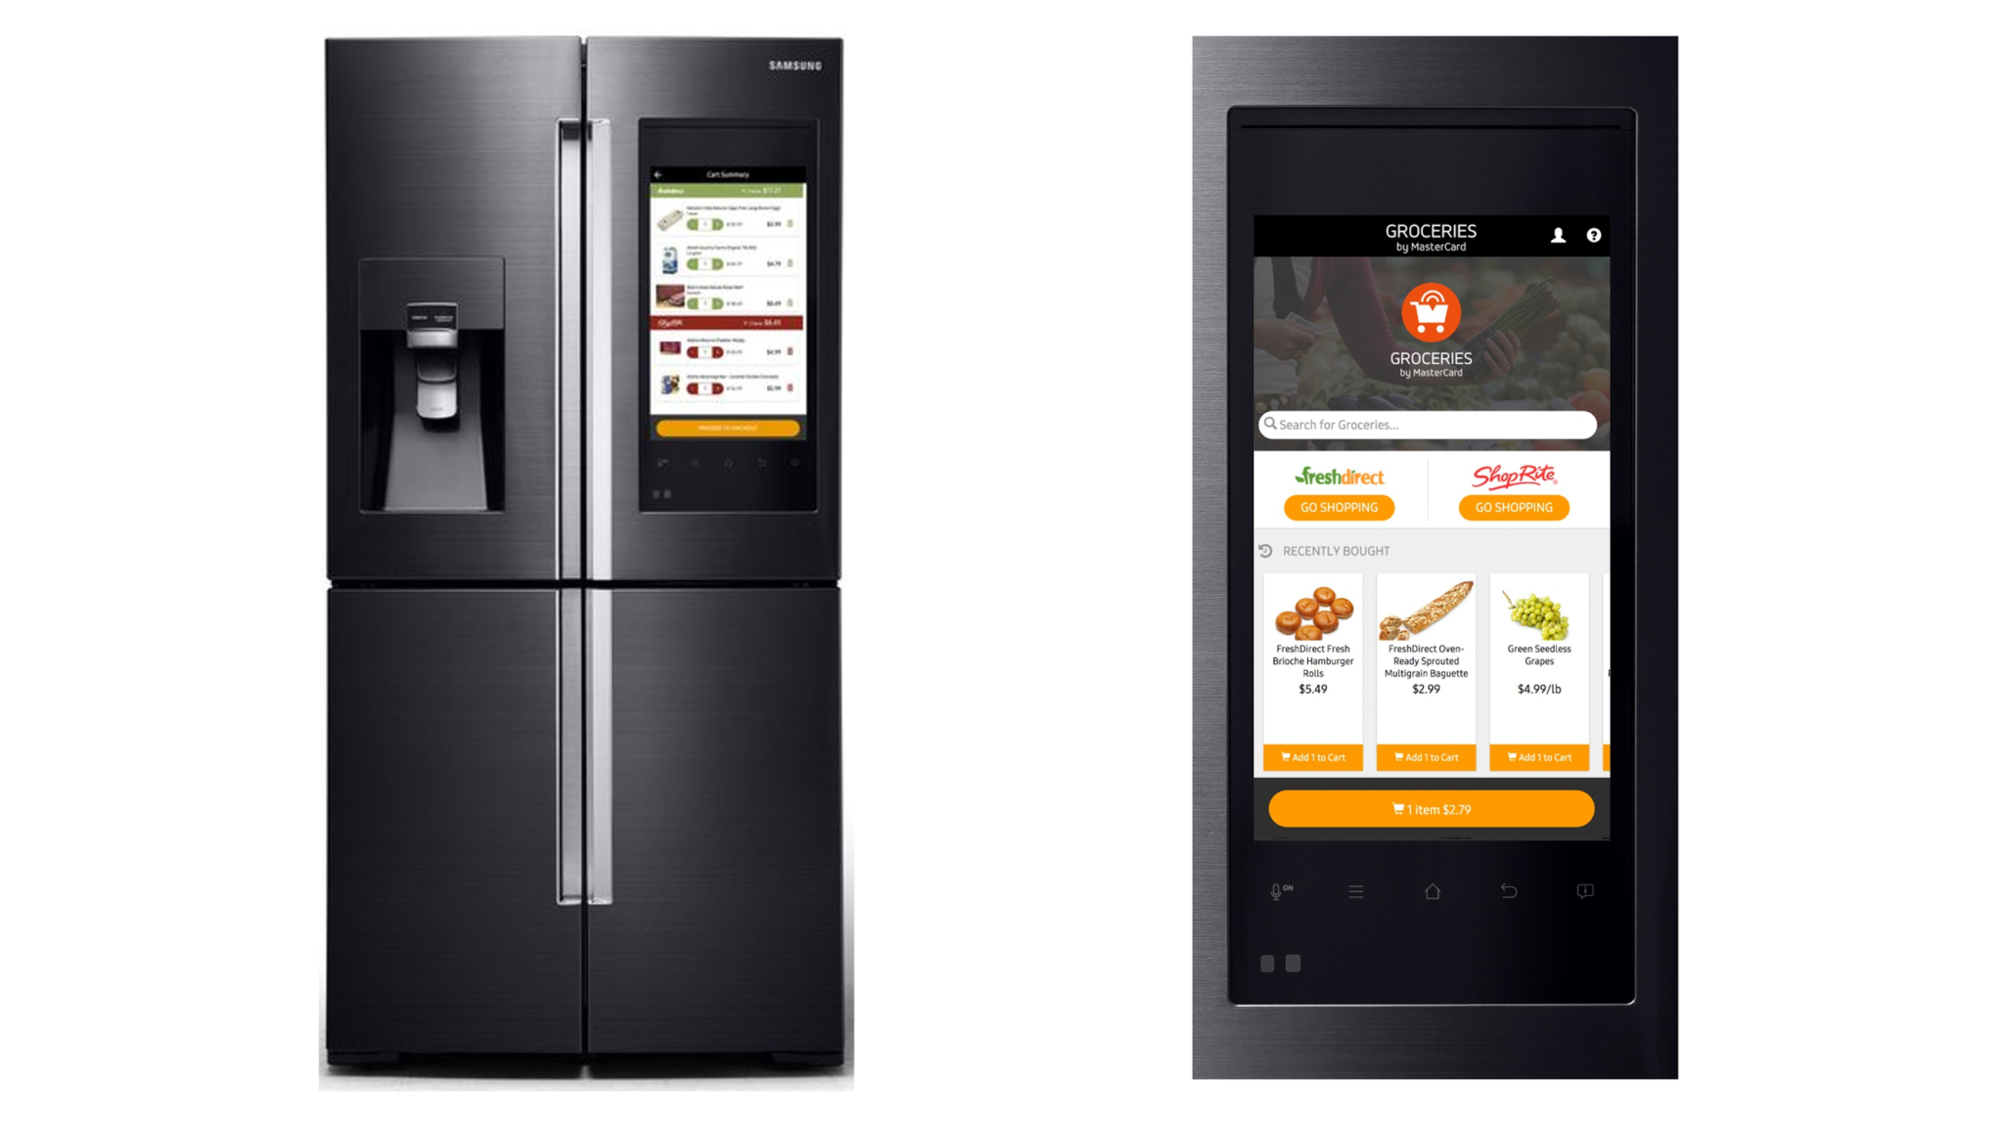
Internet of Things : Financial Services
“ IoT in financial services and banking has been embraced even before its definition. Examples are biometric scanners in ATMs, connected devices in insured cars .“
Benefits : IoT in Financial markets
Collection of data constantly and in real-time
Behavior triggered marketing actions
Instant communication between devices
Barriers : IoT in Financial markets
Privacy and security concerns
Regulatory compliance
Lack of compliance standards
Some Implementation of IoT in Financial services :
Visa Mobile Location Confirmation
Alfa- Bank Sense mobile application
Groceries by Master card

Slide 7
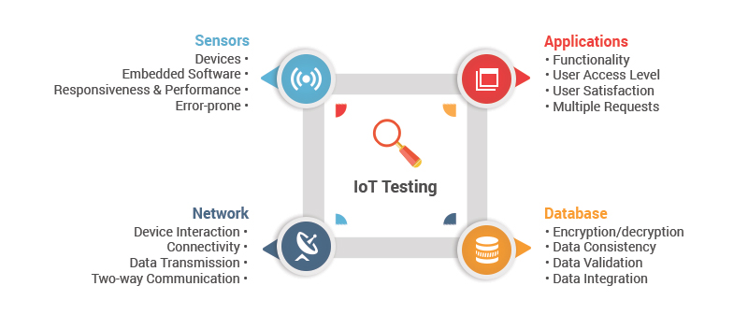

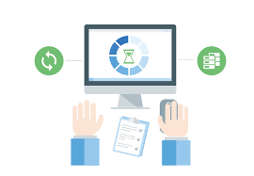
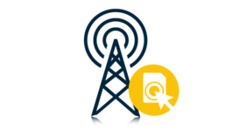
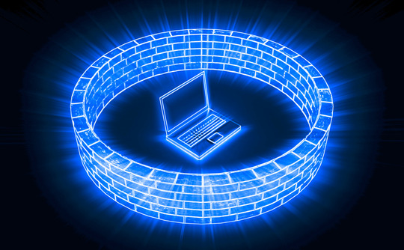
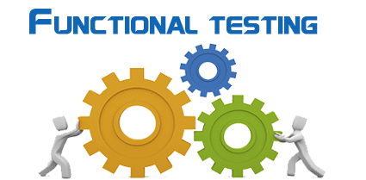

IoT Testing Types
Testing Types :
Functionality Testing : Web UI, embedded and back-end computing.
Performance Testing : Network communication and internal computation.
Security Testing : Privacy Autonomy and Spying
Compatibility Testing : Possible combination of device version, protocol version, mobile devices and mobile OS version.
Exploratory Testing : Beyond functional requirements and structures testing.
Testing Areas : IoT
Connectivity
Security
Compatibility
Performance
Functionality
Exploratory

Slide 8







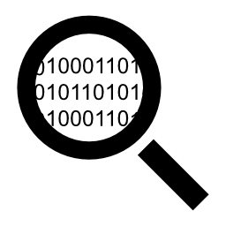
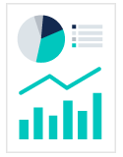

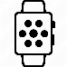
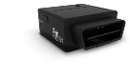






IoT Testing Strategy
Data Collection
Data Storage
Data Aggregation & Persistence
Analytics
Reporting
Application Development & Services platform
Device Gateway / Hub
Device Layer
Internal Communication Layer
Notification Configuration
System of Records
Emergency Response Notification
Monitoring & Alert management
Events/Subscription
Dashboards
Role based access- Identify
Admin & Platform apps
Collaboration & Language tools
Mobile Applications
External Communication Layer
Rules Engine
Predictive Intelligence
API/WS Management
Transform & Enrichment
Intelligent Decisions
Device Registration/Authentication
Stream Processing
Customer History data
Data Management
External Systems , CRM , Clinic data
Device Health management
Real time Analytics
Cloud Data Storage Server
Device Connector /Data Ingestion

Slide 9
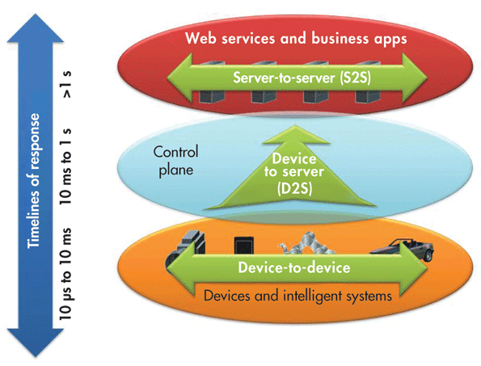
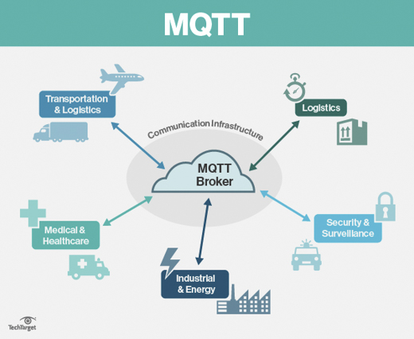
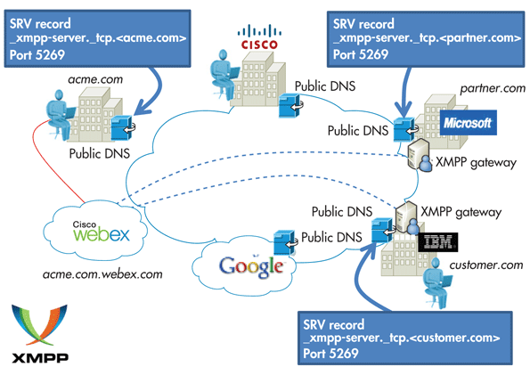
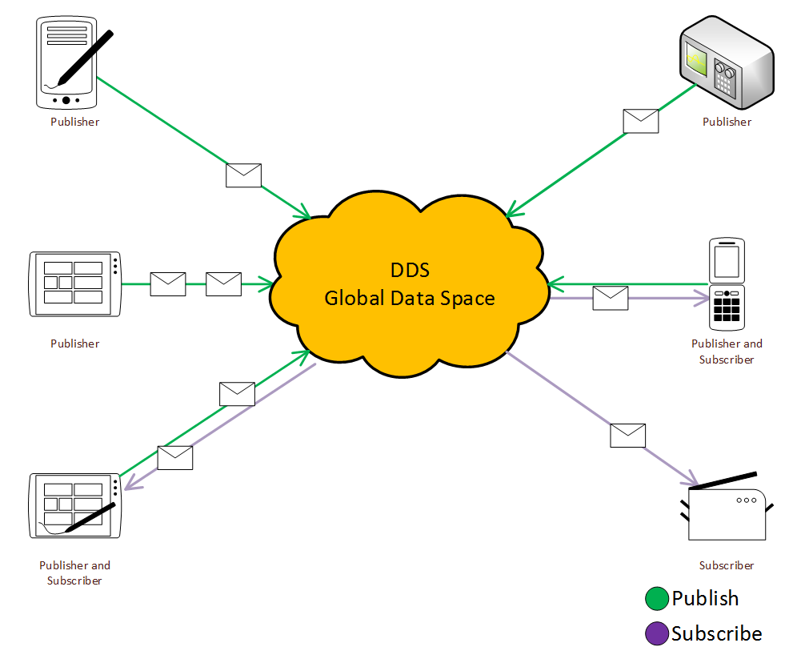
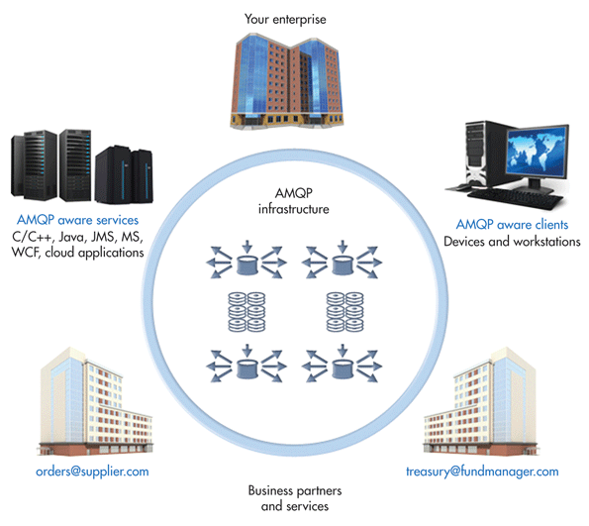
Internet of Things : Communication and Transportation Protocols
Transportation:
MQTT : Message Queue Telemetry Transport
XMPP :Extensible Messaging and Presence Protocol
DDS : Data Distribution Service
AQMP : Advance Message Queuing Protocol
Communication :
RFID - Radio Frequency code
EPC - Electronic Product code
NFC - Near Field Communication
Bluetooth
Wi-Fi

Slide 10
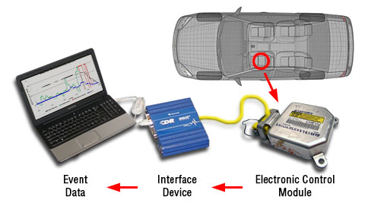

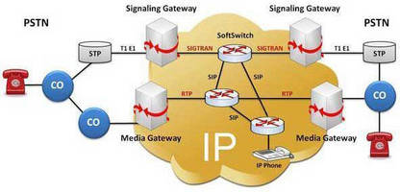
IoT Testing Challenges and needs
“Software Testing Challenges go beyond devices and sensors to include the added complexity that comes with big data (i.e., huge volume, velocity and variety), which makes validation of real-time IoT certification a major challenge “
Internet of Things : QA Complexity
Device interaction layer
Interoperability
Security
User interaction layer
Usability and User experience
IoT Services and IoT environments
IoT Testing Needs
Protocol Simulation
Data recorders
Virtualization

Slide 11


Cognizant IoT QA Solutions
1
2
TEBOT
Extreme
Virtualization/ Simulation
Test Robot platform
Rapid shift from sheer testing of applications in a defined environment to testing the experience in a dynamic environment
Robotic Test platform to help accelerate development and testing to automate various smart devices (wearable, home automation kits, etc).
* BLUELink and Tebot are Cognizant’s Propriety patent Pending IoT Solutions

Slide 12









BLUElink
Hardware Virtualization Solution for IoT
An IoT hardware/Sensor Virtualization Solution that enables to perform early development and testing without having the dependency on real devices
IoT Cloud load generation testing
BLE Peripheral Virtualization
IoT Platform Integrations
Sensor Virtualization
Simulate load generation for connected IoT devices
Telematics – Connected car OBD fault code simulation
Vehicle asset/data simulation for cloud testing
“BLUElink on Demand” – A load testing offering via fastest2.0
Temperature
Pressure
Load
Flow
Gas
Stress
Level
Sound
Proximity
Virtualize any smart devices that used Bluetooth as protocol to communicate
For E.g
Medical body path
BLE Enabled BP reader
Smart air purifier
Smart vacuum cleaner
Smart kitchen appliances
Protocols :
MQTT
Wi-Fi
LAN
BLE
Zigbee*
We are here

Slide 13
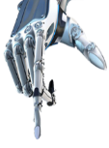
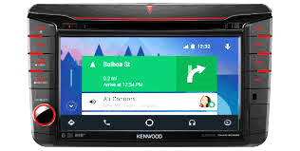
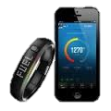

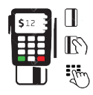
Tebot
Test Robot Platform for IoT QA
Robotic Test platform to help accelerate development and testing to automate various smart devices (wearable, home automation kits, Point of Sale, payment devices, Car IVI Unit , Touch Kiosk, etc. ).
Touch Screen/Kiosk Devices
Smart Home Automation
Point –of-Sales / Payments Device
Wearable/Fitness tracker Automation
Rotary based controls
3-D Robotic plotter
(Pinpad, Thermostats, etc..)
Card Swipe in/ out ( sideways)
Chip Card Insert / Exit
NFC Tap
Multi card slot
E-Signature authorization
Valid/Invalid PIN entry
IVI – Car Dashboard automation ( Android auto / Apple Car play )
Visual Capture for LCD devices
Image analysis and validation
Remote execution for TEBOT
Door Sensor
Motion Sensor
Sound / Glass Break Sensor
Flood Sensor
Motion Detecting Camera
LDR based LED detection
Amazon Alexa Integration ( TTS )
Smartwatches /Smart Phones
Wearables / Fitness Trackers
Pedometer based devices
Heath tracker body patches
Physical Activities (Walk, run etc..
Human Profiles (Athletes, Senior Citizens etc..)
We are here
TYPE 2
TYPE 3
TYPE 1

Slide 14
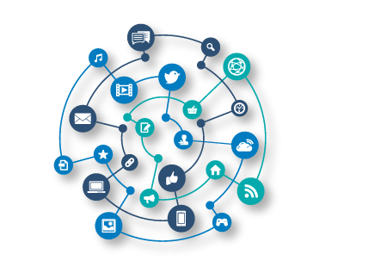
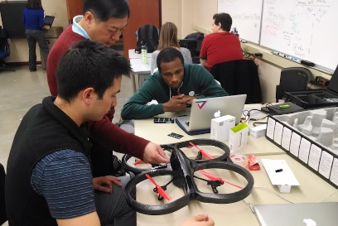

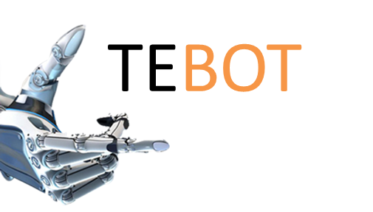



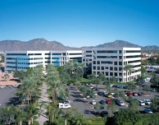





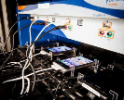




IoT QA @ Cognizant
35+ Active Projects
250+ IoT Testers
Home Grown IoT QA Platforms
IoT QA Labs Research and Sand BoX Environment
Partnership
INFRASTRUCTURE
INDUSTRY RECOGNITION
Near
Shore
500+
devices
in Phoenix, Arizona
ON demand Device Lab
Help reduce CAPEX spent on mobile devices during certification

Slide 15
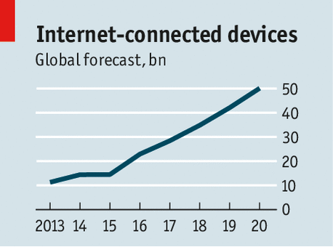
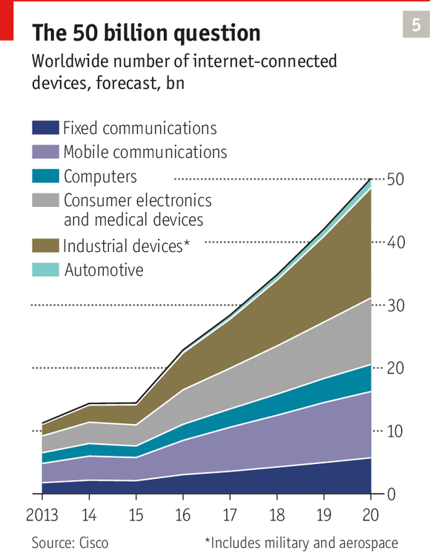
Internet of Things: Industry perspective
Gartner :
Internet of Things Installed Base Will Grow to 26 Billion Units By 2020.
Economic value-add is forecast to be $1.9 trillion across sectors in 2020.
For the Future :
By introducing enough data about the world, the IoT can help drive the creation of models that approximate the underlying physical drivers of even intangible financial measures.
Mobile devices: smartphones, tablets and smart-watches are now the most widely recognized applications of IoT in bank and financial services industry. The progress in technology allows much wider application going far beyond simple communication with consumers.

Slide 16
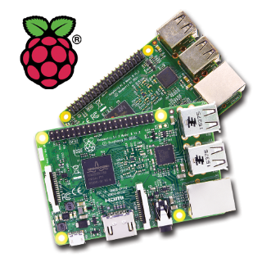
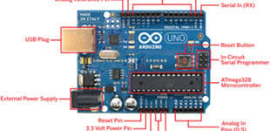
Building your own IoT devices @ Home
Raspberry Pi :
The Raspberry Pi is a series of small single-board computers developed in the United Kingdom by the Raspberry Pi Foundation to promote the teaching of basic computer science in schools and in developing countries.
Arduino :
Arduino is an open source computer hardware and software company, project, and user community that designs and manufactures single-board microcontrollers and microcontroller kits for building digital devices and interactive objects that can sense and control objects in the physical world.
***Raspberry pi and Arduino in conjunction with required hardware and software, we can build our own IoT system @ home e.g., Monitoring home temperature etc.

Slide 17
“Doing” Digital -> “Being” Digital – Prepare Yourself for IoT Wave
IoT Academy trainings :
Digital 101 -> IoT 101 :https://cmooc.cognizant.com/course/index.php
Academy programs :
Learning: Digital Assurance 101 | Course Code: CTKEG114 | Activity: CTKEG114
Learning: Digital Assurance L0Program Code: PS1733
Episteme:
https://episteme.cognizant.com/asset/iot/
https://episteme.cognizant.com/products/tebot/
https://episteme.cognizant.com/products/bluelink-2/
For all IoT QA related Queries/Support log a request @ https://episteme.cognizant.com/ -> Biz Dev
Notes:
Define business goals and the expected outcome
participating in the connected solution
Prepare the data points and metrics aligned with the outcome
Define the device connectivity and data format
Implement security, governance, and policy across each layer
Identify reference datasets required for transforming sensor data
Factor in machine learning and predictive analytics
Define hot path analytics for near real-time processing
Define cold path analytics for long-term, batch processing

Slide 18
Q&A Session Thank you !!!

